Slide 1
Joshua 1:1-9
1After the death of Moses the servant of the Lord , the Lord said to Joshua son of Nun, Moses' aide:
2"Moses my servant is dead. Now then, you and all these people, get ready to cross the Jordan River into the land I am about to give to them-to the Israelites.
3I will give you every place where you set your foot, as I promised Moses.
4Your territory will extend from the desert to Lebanon, and from the great river, the Euphrates-all the Hittite country-to the Great Sea on the west.

Slide 2
Joshua 1:1-9
5No one will be able to stand up against you all the days of your life. As I was with Moses, so I will be with you; I will never leave you nor forsake you.
6"Be strong and courageous, because you will lead these people to inherit the land I swore to their forefathers to give
them.
7Be strong and very courageous. Be careful to obey all the law my servant Moses gave you; do not turn from it to the right or to the left, that you may be successful wherever you go.

Slide 3
Joshua 1:1-9
8Do not let this Book of the Law depart from your mouth; meditate on it day and night, so that you may be careful to do
everything written in it. Then you will be prosperous and successful.
9Have I not commanded you? Be strong and courageous. Do not be terrified; do not be discouraged, for the Lord your God will be with you wherever you go."

Slide 4
LEARNING LESSONS OF FAITH FROM THOSE WHO HAVE GONE BEFORE

Slide 6
Joshua 1:1-9

Slide 7
Be strong and courageous
Joshua: The new leader in the new context.
Be strong and courageous: Digression #1
Be strong and courageous: Digression #2
Jesus: The new leader in the new context.

Slide 8
1. Joshua: The new leader in the new context
What preceded:
Abraham & family living in Canaan, (Israel) – 300 years
Israelites living in Egypt (eventually as slaves) – 350 years
Under Moses: the Israelites in the ‘wilderness – 40 years.
Then … when of entering the promised land, Moses dies.
So Joshua the ‘assistant’, is appointed leader ...

Slide 9
1. Joshua: The new leader in the new context
Thematic Context:
The People
The Land
God’s Grace
“Many other people went up with them,” Exodus 12:38
“…To your descendants I give this land”
Genesis 15:18
“Good and upright is the Lord, therefore he will teach sinners in his ways.” Psalm 25:8

Slide 10
1. Joshua: The new leader in the new context
Joshua was given specific details, not just ‘values’.
Remember God’s promises 1:6 “the land I swore to … give”
Remember God’s principles
1:7-8 “…obey…the Book of the Law meditate on it..
Remember God’s presence
1:9 “do not be discouraged…the Lord will be with you.”
(Sonja Downing)

Slide 11
1. Joshua: The new leader in the new context
What followed:
‘the judges’ period 300 years
‘the kings’ period, 400+ years
‘the exile’ in Babylon 70 years
danger of assimilation, idolatry, war & exile

Slide 12
1. Joshua: The new leader in the new context
Joshua’s leadership role.
1:4 “…you will lead my people…”

Slide 13
Be Strong and Courageous
Digression #1 Be Strong
Notes:
Exercise does this:
Increases neurotransmitters dopamine, serotonin & noradrenaline
Decreases cortisol (a stress hormone)
Increases the number of mitochondria in the muscles
Improves cholesterol numbers and blood glucose control
Improves coordination, strength and stamina.

Slide 14
Be Strong and Courageous
Digression #1 Be Strong
Benefits of Exercise
Improved
Mood and motivation, thinking and learning,
Balance, strength and joint health,
Body fat percentage,
Sleep.
Less
Anxiety, stress and depression,
Heart disease, type 2 diabetes, and (some) cancers,
Falls, bone fractures and osteoporosis.
Notes:
Short Term Benefits of Exercise:
Better mood for 2 hours
Better mental focus and attention span
Better memory.
Shorter reaction times.

Slide 15
Be Strong and Courageous
Digression #2 Face your Fears

Slide 16
Be Strong and Courageous
Digression #2 Face your Fears
“my greatest fear is…”

Slide 17
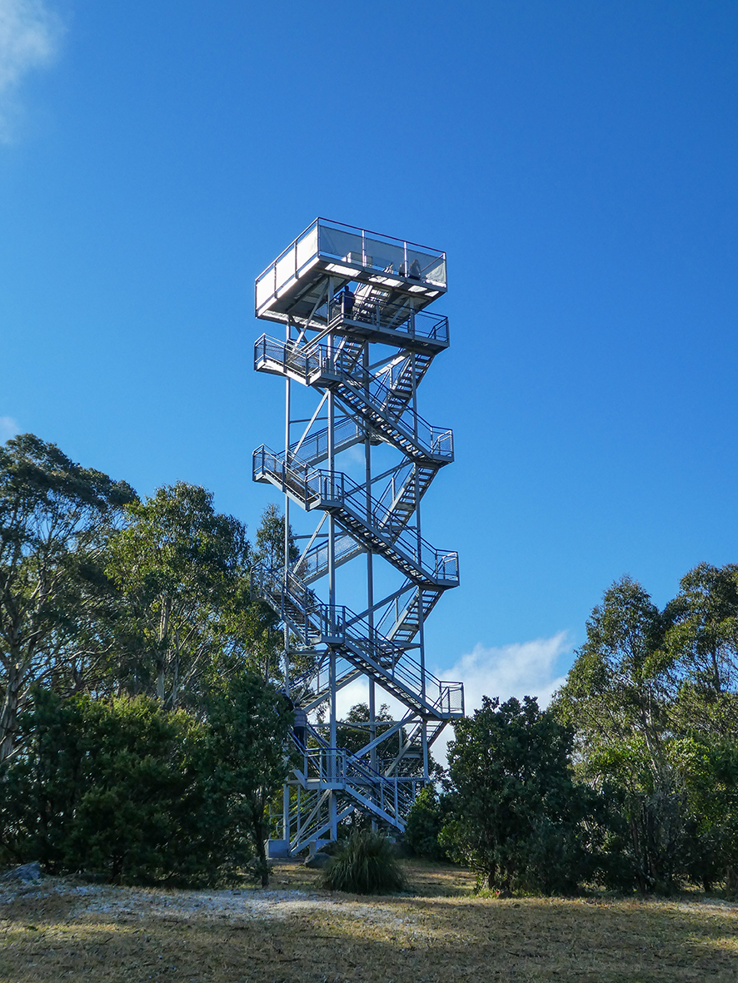
Digression #2 Face your Fears
“my greatest fear is…”
“the 9 levels of trial”
AKA Mt Donna Buang observation tower

Slide 18
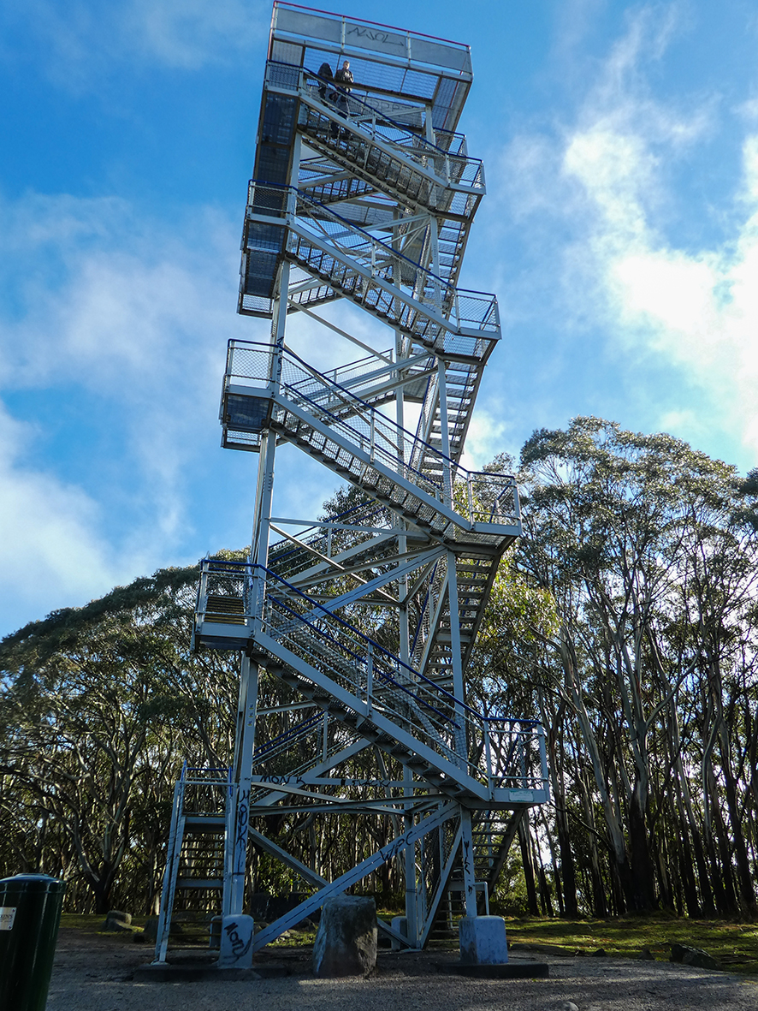
Digression #2 Face your Fears
“my greatest fear is…”
“the 9 levels of trial”
AKA Mt Donna Buang observation tower

Slide 19
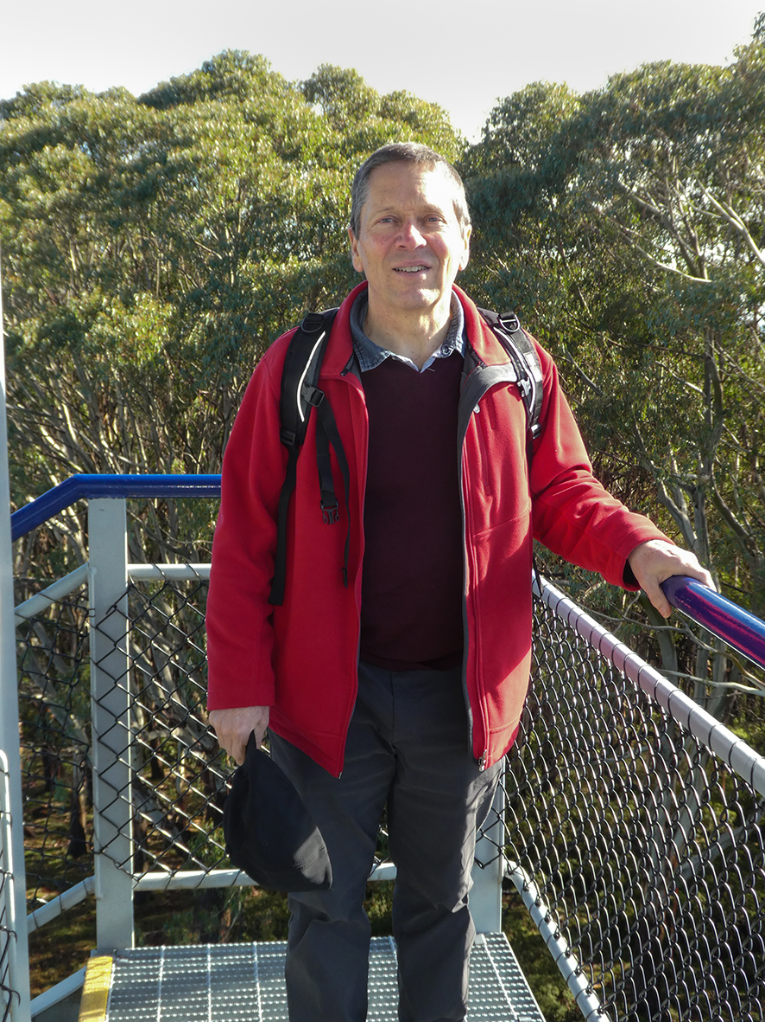
Digression #2 Face your Fears
“my greatest fear is…”
“the 9 levels of trial”
AKA Mt Donna Buang observation tower

Slide 20
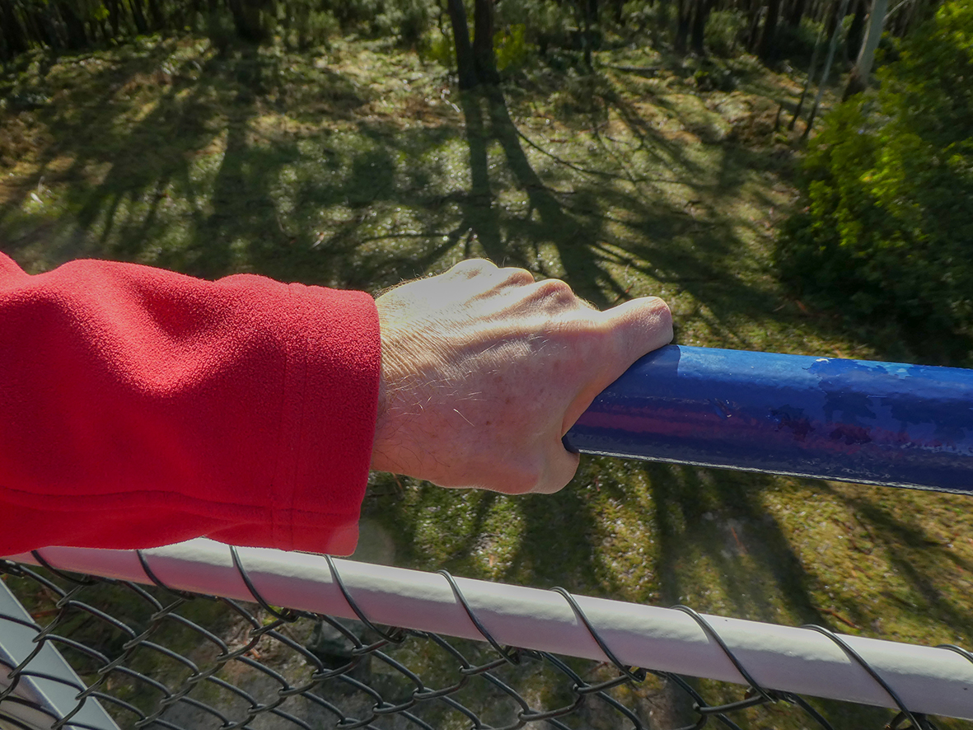
Be Strong and Courageous
Digression #3 Face your Fears
“my personal tower of fear, all 9 levels ”
Mt Donna Buang observation tower

Slide 21
Be Strong and Courageous
Digression #2 Face your Fears
“my greatest fear is…”
Notes:
Addictive behaviour is the result of a primal desire to self-sooth. Anything can operate as an addiction if done habitually and for the purpose of fulfilling a need to be tolerably numb. We turn to addiction to escape pain, but the escape itself perpetuates our pain, and thus begins a dangerous spiral.

Slide 22
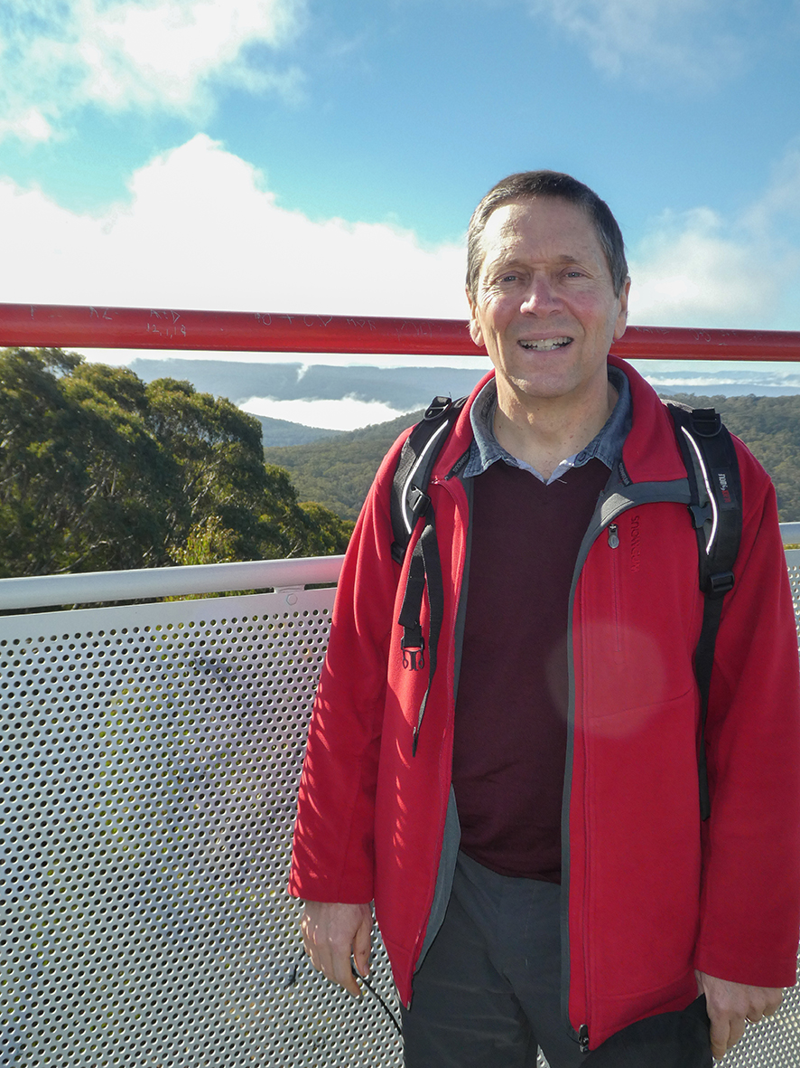
Be Strong and Courageous
Digression #2 Face your Fears
“my greatest fear is…”

Slide 23
2. Jesus: The new leader in the new context.
Remember God’s promises in Jesus
…the merciful, …shall receive mercy.
Remember God’s principles in Jesus
Love one another.
Remember God’s presence in Jesus
…where two or three gather in my name, there am I with them.
And maybe plan some regular exercise, and bring a friend.
And write down your greatest fear and face it, with a friend.

Slide 24
JOSHUA
achieving all that God has for us to do in life

